Slide 1


Project name: Multi-Axis Cobot For Factory Automation
Team members: Adrian Guzman, Emily Hamsa, Ethan Woods, Jaishil Shah
Notes:
Ethan

Slide 2

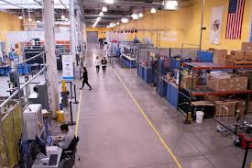
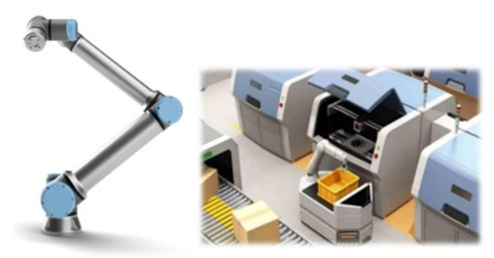
Project Description
Problem statement:
Factory settings pose dangerous environments to human workers through the exposure to heavy machinery, tight spaces, and repetitive workloads. These hazards increase chance of injury and worker burnout. We need to implement collaborative robots (Cobots) to improve worker conditions.
Human Injury & Burnout in Warehouses
Cobot Solution
Notes:
Adrian

Slide 3
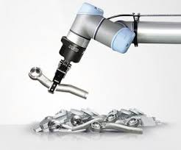
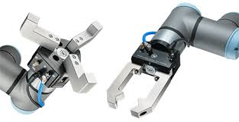
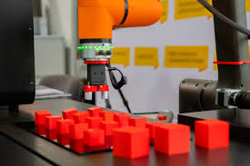
Project Description
Solution proposal:
Develop a Cobot that can integrate into a factory environment to reduce human injury, worker burnout, and increase productivity in repetitive tasks. The Cobot shall be able to lift (1-2 lbs) and be placed into tight environments and controlled wirelessly through mobile app.
Repetitive Tasks
1-2 lbs. Load
Precise Control
Notes:
Ethan

Slide 4
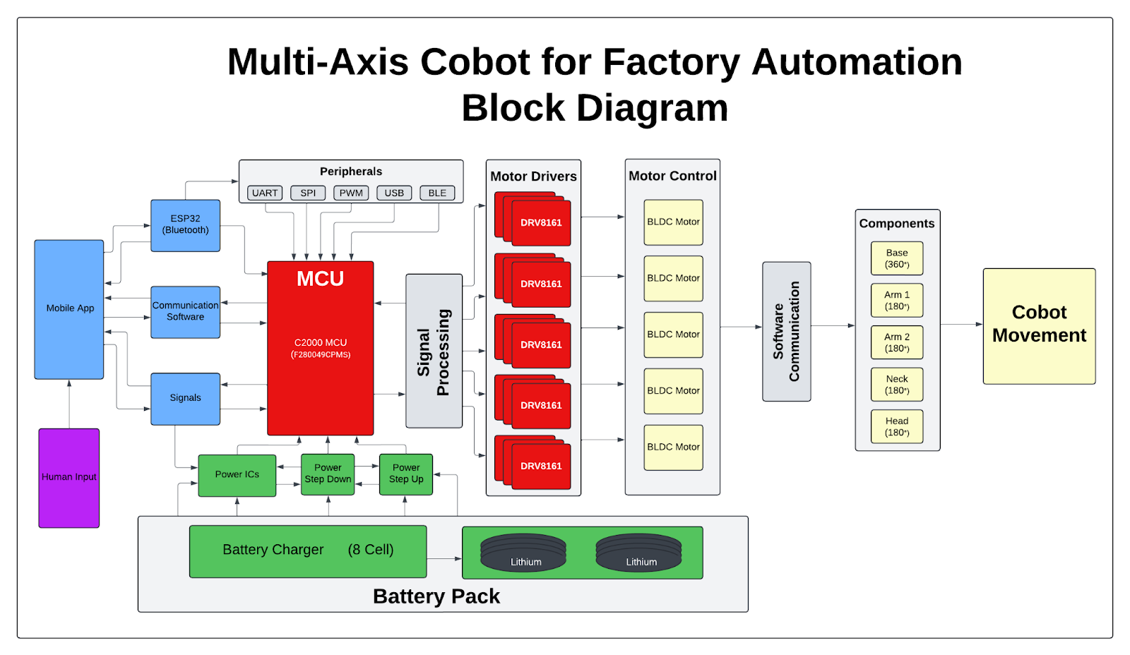
Diagram of subsystems and interface
Subsystem Diagram Color: Power, MCU/Connectivity, Mobile App, Motor Control

Slide 5
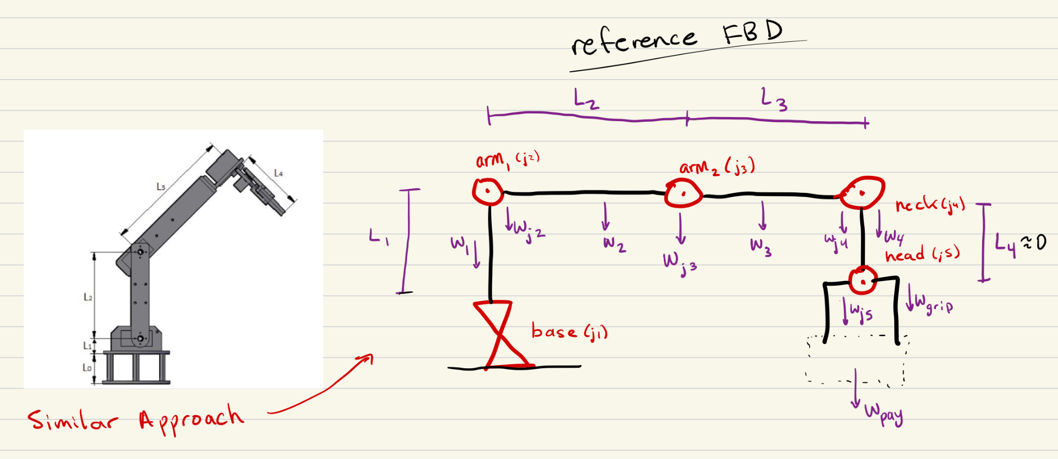
Motor Specifications
Motor/Motor Driver Subsystem
Ethan Woods
Challenges:
Not super conditioned in physics. FBD and ensuing calculations needed relearning
Constructing range of values to account for variance in materials, payload weight, and speed of robot arm
Requires expensive motors in a low budget project
Lots of assumptions
Based on possible payload, component size, acceleration speed and material composition, determined a range of possible motor strengths needed:
Motor Name | Low Range Torque | Mid Range Torque | High Range Torque
Base Motor | .1428 N/m | .5339 N/m | 1.993 N/m
Arm 1 Motor | 563 oz*in | 1197 oz*in | 2763 oz*in
Arm 2 Motor | 181.72 oz*in | 354 oz*in | 745 oz*in
Neck Motor | .00649 N/m | .00973 N/m | .0129 N/m
Gripper Motor | 11 kg/cm | 11 kg/cm | 11 kg/cm

Slide 6
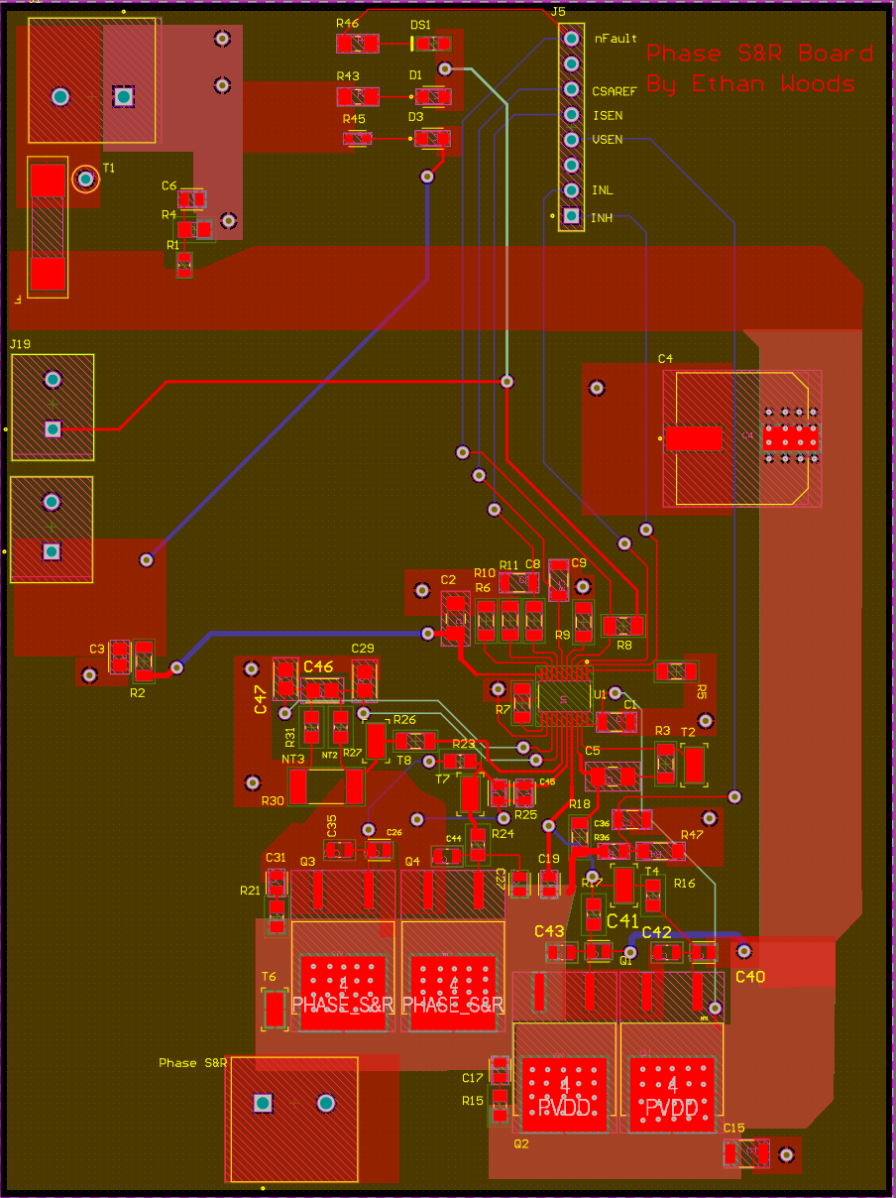
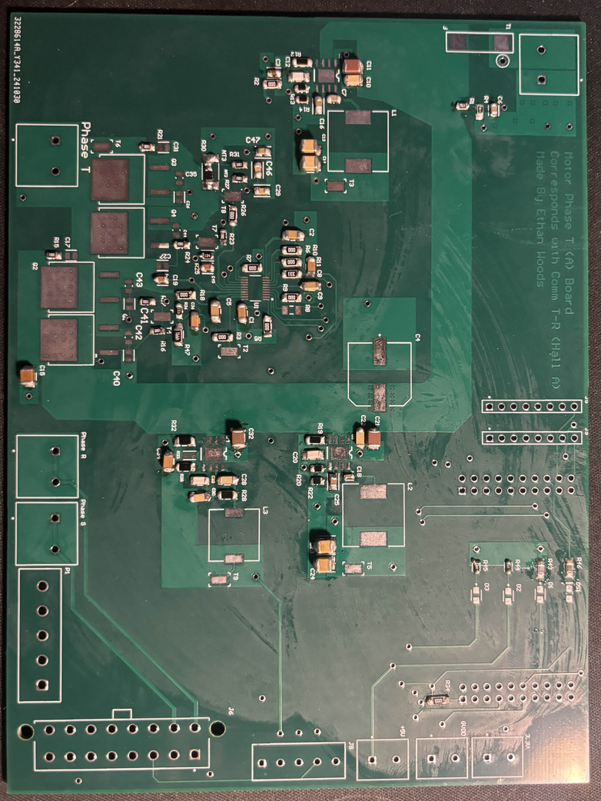
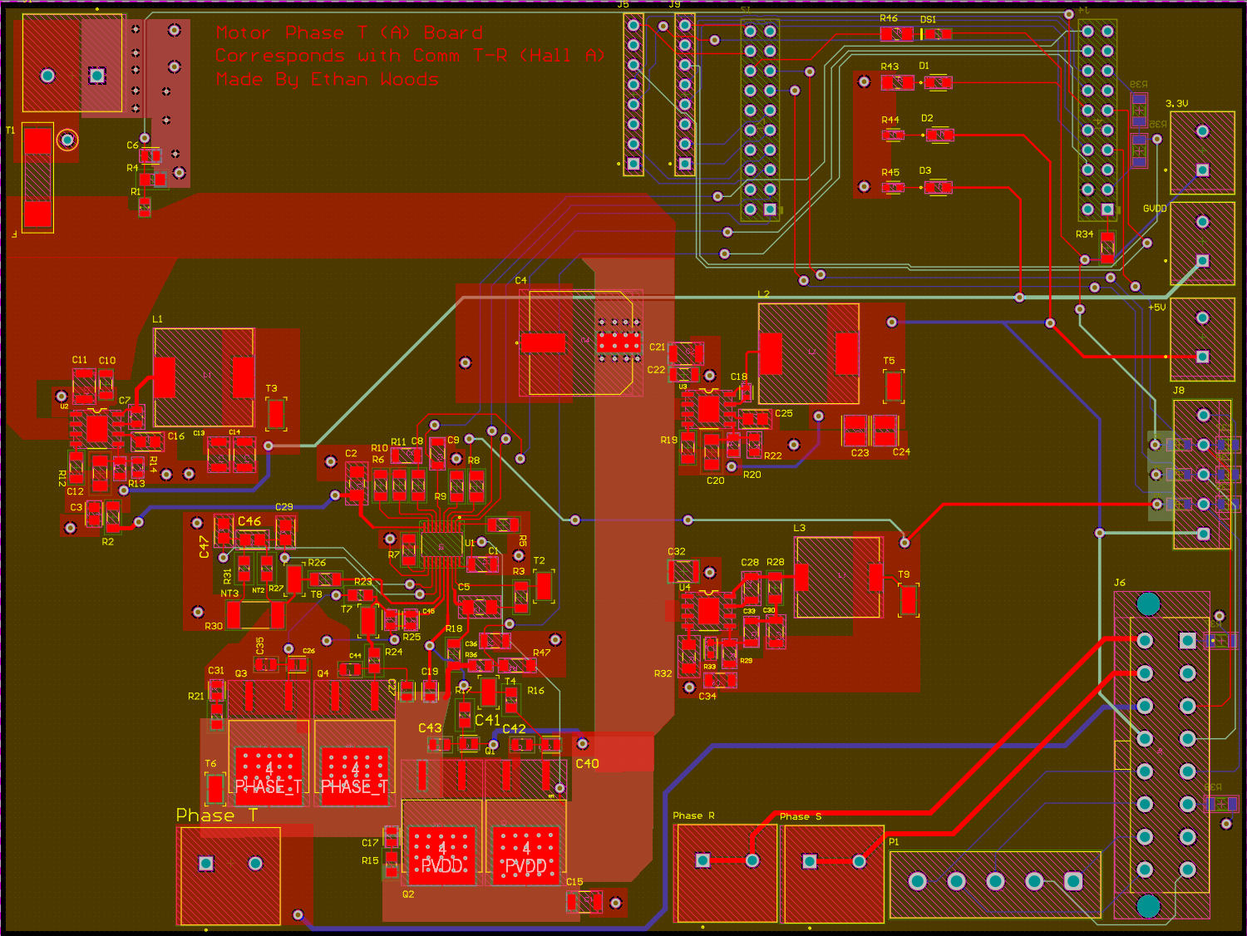
Phase Generation Boards
Motor/Motor Driver Subsystem
Ethan Woods
Challenges:
Complexity of Circuits… < 40 components in Motor Driver circuit by itself
12V, 5V, 3.3V Voltage step-downs from 48V input required to operate board.
Long ordering times: just got all parts in middle of last week.
Small components: almost all 0805 components with some 0603
Created 2 different complex boards to demonstrate Phase Generation to spin 3-Phase BLDC Motor:
Phases B&C: 76 Components (each)
Phase A Board: 136 Components
Board 1 Progress: Done w/ resistors/capacitors

Slide 7
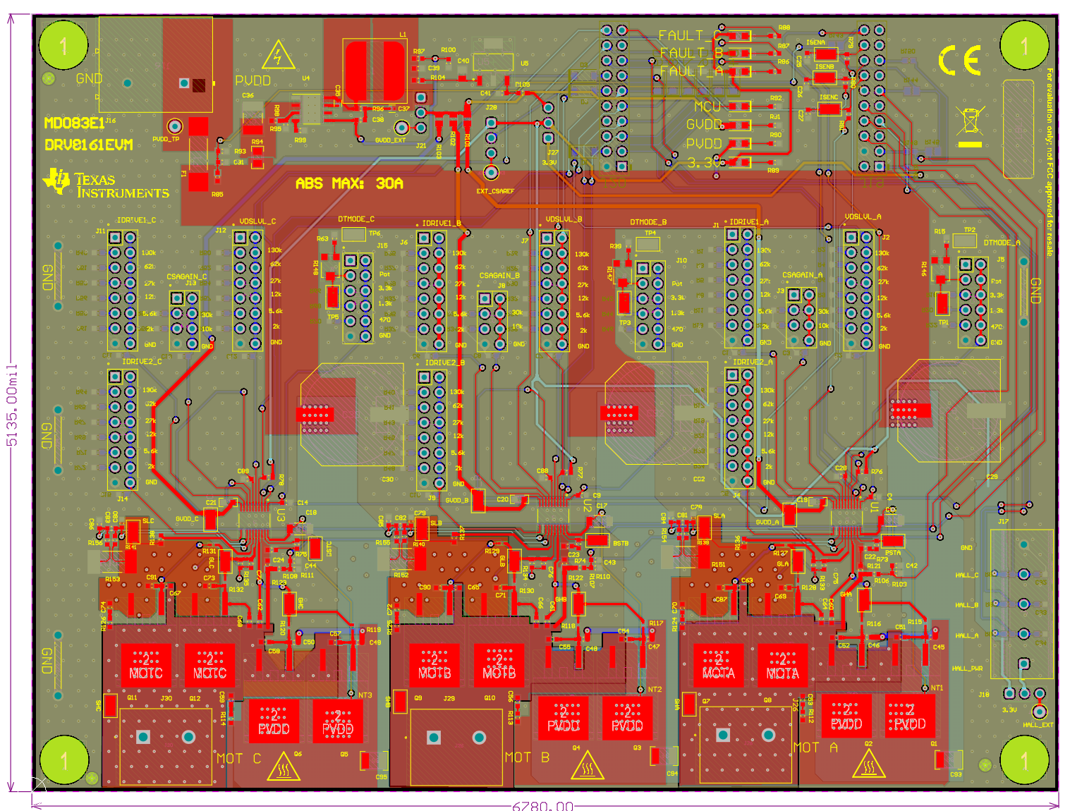
Remaining Tasks
Motor/Motor Driver Subsystem
Ethan Woods
Main Goals in 404:
Final PCB design for all 3 Phases on ONE board
Voltage step-downs handled by Power Subsystem or on board
TI DRV8161 Evaluation Board (example):
This board will be able to take input signals from C2000 MCU and generate PWM Phase Signals as needed.
Ultimately, given an input on the mobile app, spin a motor as needed for each motor from a signal generated by the MCU.
Finish Soldering All 3 Boards
Finish Soldering Phase A Board
Start and Finish Soldering Phase B & C Boards
Power the Boards and Test
With the help of the C2000 Launchpad, successfully output Phase Signals A, B and C. Should be able to have an individual signal on each board to show each Motor Driver Circuit works correctly.
Finally, spin the 3-Phase BLDC Motor!
Route all Phase Signals to Board A and plug in the motor! It should spin through the help of the Launchpad.

Slide 8
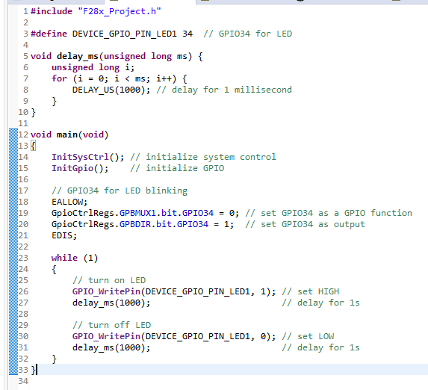
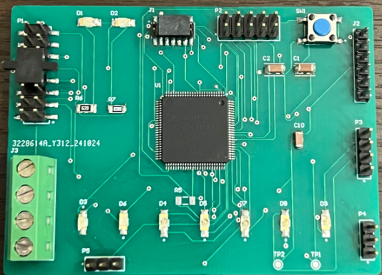
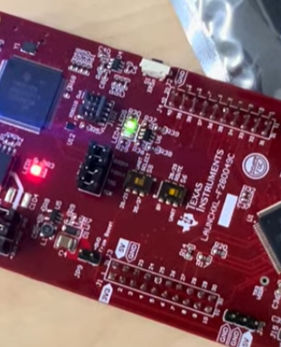
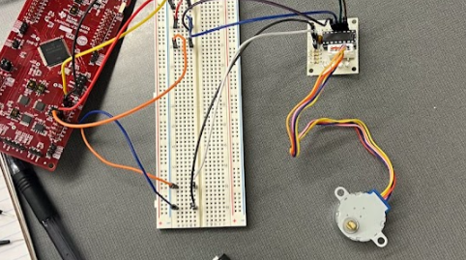
Engineering Design Accomplishments
MCU/Processing
Adrian Guzman
Evaluation Board
connected to evaluation board & flashed MCU
software development to understand communication between CCS and MCU
LED blink program (control GPIO pins)
program to spin Servo motor
program to rotate 4 phase stepper motor with external motor driver (from stem kit)
PCB
schematic & layout
solder learning on practice board
ordered and finished assembly
debugged PCB board
verified headers get correct signals
ensure no voltage drop off (3.3V)
attempting to connect to XDS debug probe to flash my own MCU on PCB
Finished assembly of PCB
EVM software
4 phase Stepper Motor Movement on eval board
LED blinking on eval board

Slide 9
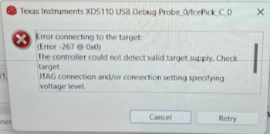
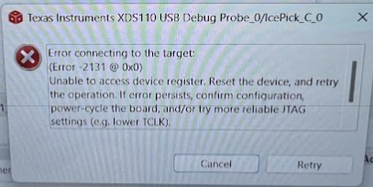
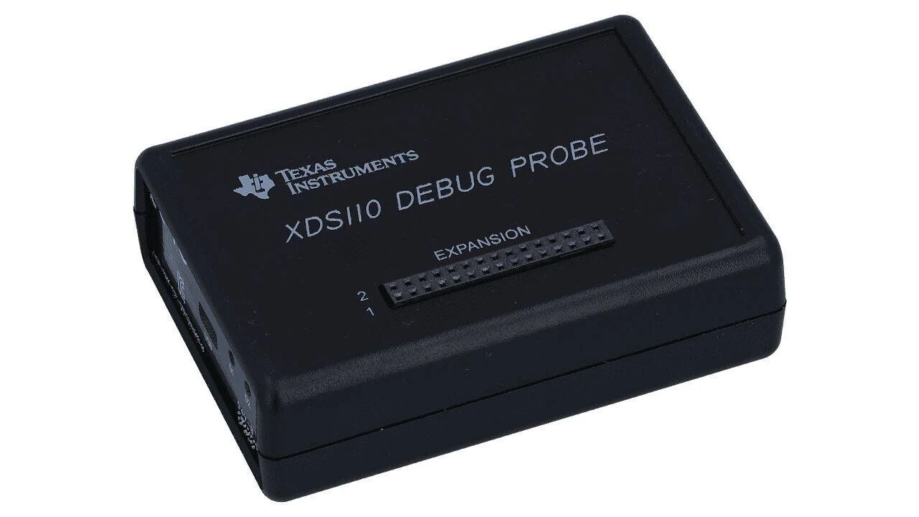
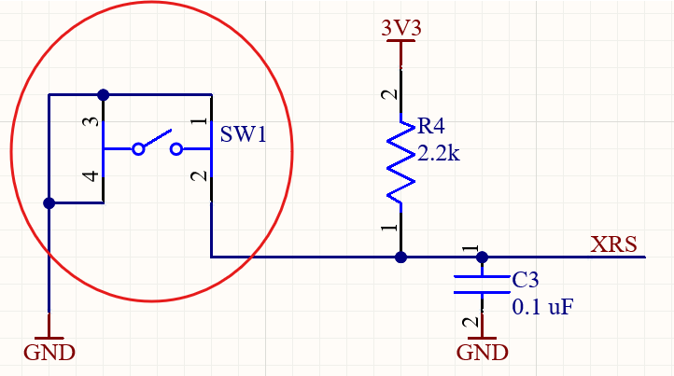
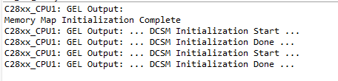
Challenges
MCU/Processing
Adrian Guzman
XDS110 debug probe not connecting to MCU on PCB
error messages (Error -2131 & -267)
resolved error -267 (needs constant 3.3v)
voltage drop off within PCB when not enough amperage on power supply
discussed with Dr. Lusher, need to set supply to 500mA and MCU will pull necessary current
error in schematic, reset button is shorting to GND, need to exacto knife pin-1 & pin-3 trace on PCB
Debug Probe Error Messages
XDS110 Debug Probe (interface between MCU and computer)
How probe should work (results from eval board connection)
Reset Button Short

Slide 10
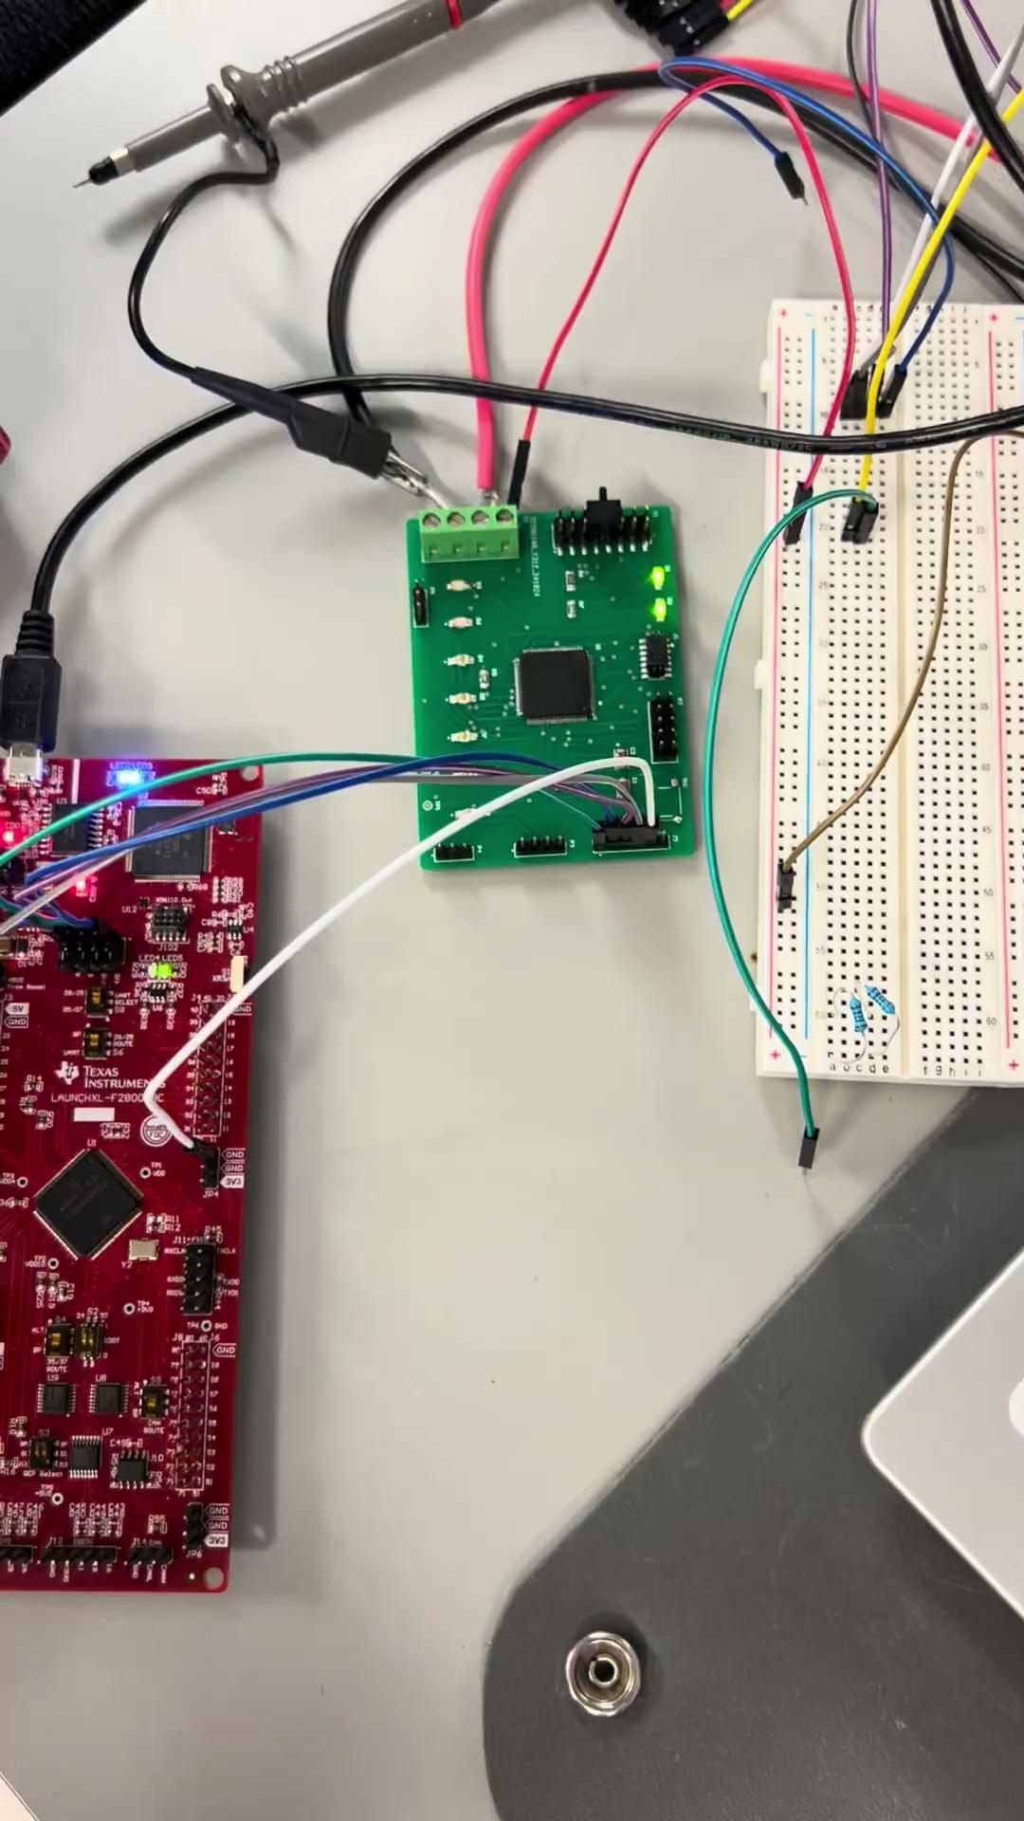
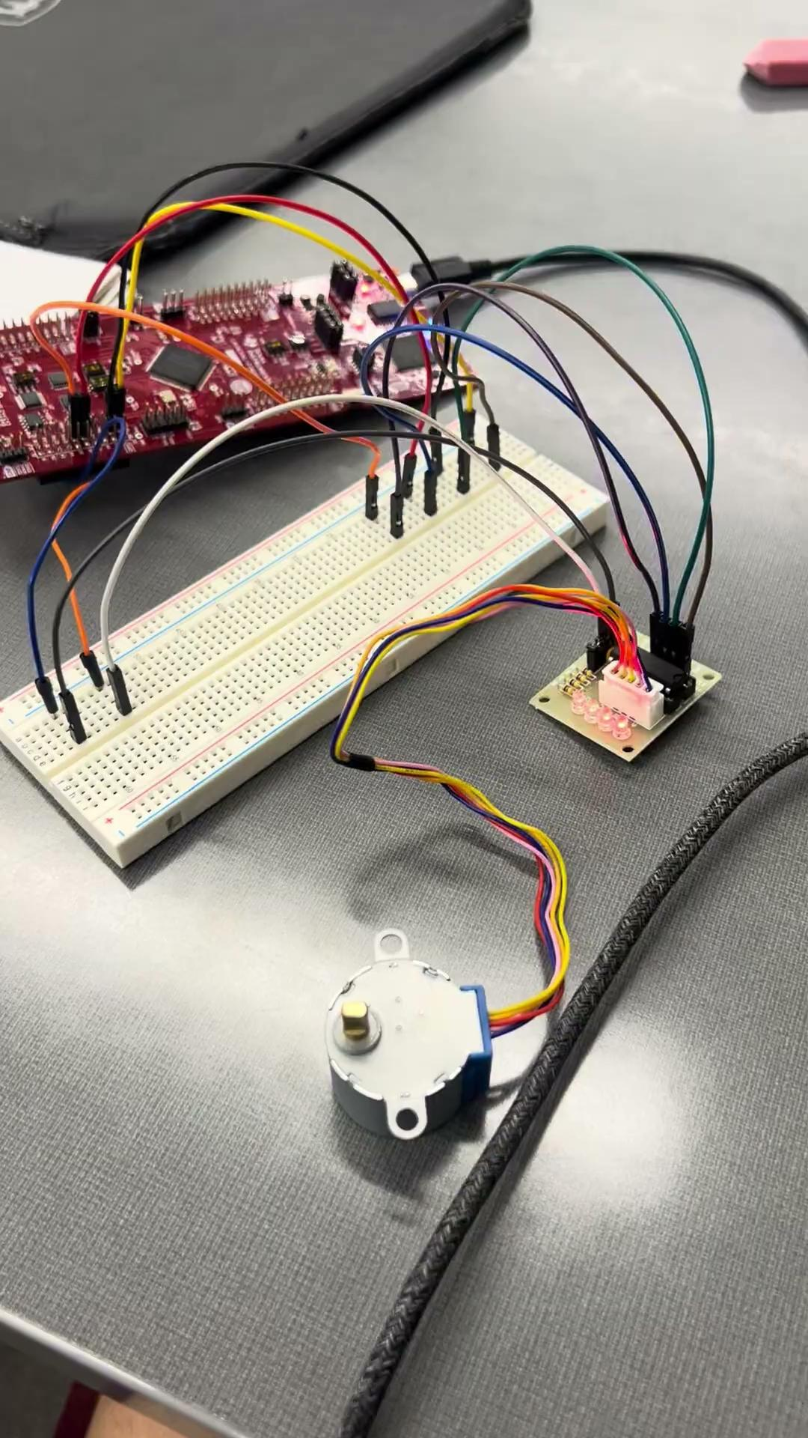
Video1 - LED blinking Demo on PCB
Video2- Stepper motor via launchpad

Slide 11
Remaining Tasks
MCU/Processing
Adrian Guzman
Remaining 403 tasks
connect PCB to XDS110 debug probe, will allow me to flash software to MCU through CCS software developer
flash software programs (blinking LED & rotating motor) to MCU to show at demo, already verified on eval board, replicate on PCB
ideally, partial integration with motor driver (Ethan) & wireless (Jaishil)
404 tasks
create final revision PCB board based on learnings in 403
MCU subsystem integration with other subsystems, specifically, take in appropriate power, generate PWM for motor drivers, and connect to ESP-32
team will design housing for hardware and construct physical cobot

Slide 12
Engineering Design Accomplishments
Power and Battery Management
Emily Hamsa
Completed load list including all components throughout the cobot that will need power
Used load list to size battery and trace widths
Completed designs for schematics that convert 48 volts to 24, 12, 6, 5, and 3.3 volts
Used TI WeBench
Completed PCB layout and routing, and ordered board and parts
Completed PCB assembly
In preparation, completed a soldering practice board
Working on the debugging process

Slide 13
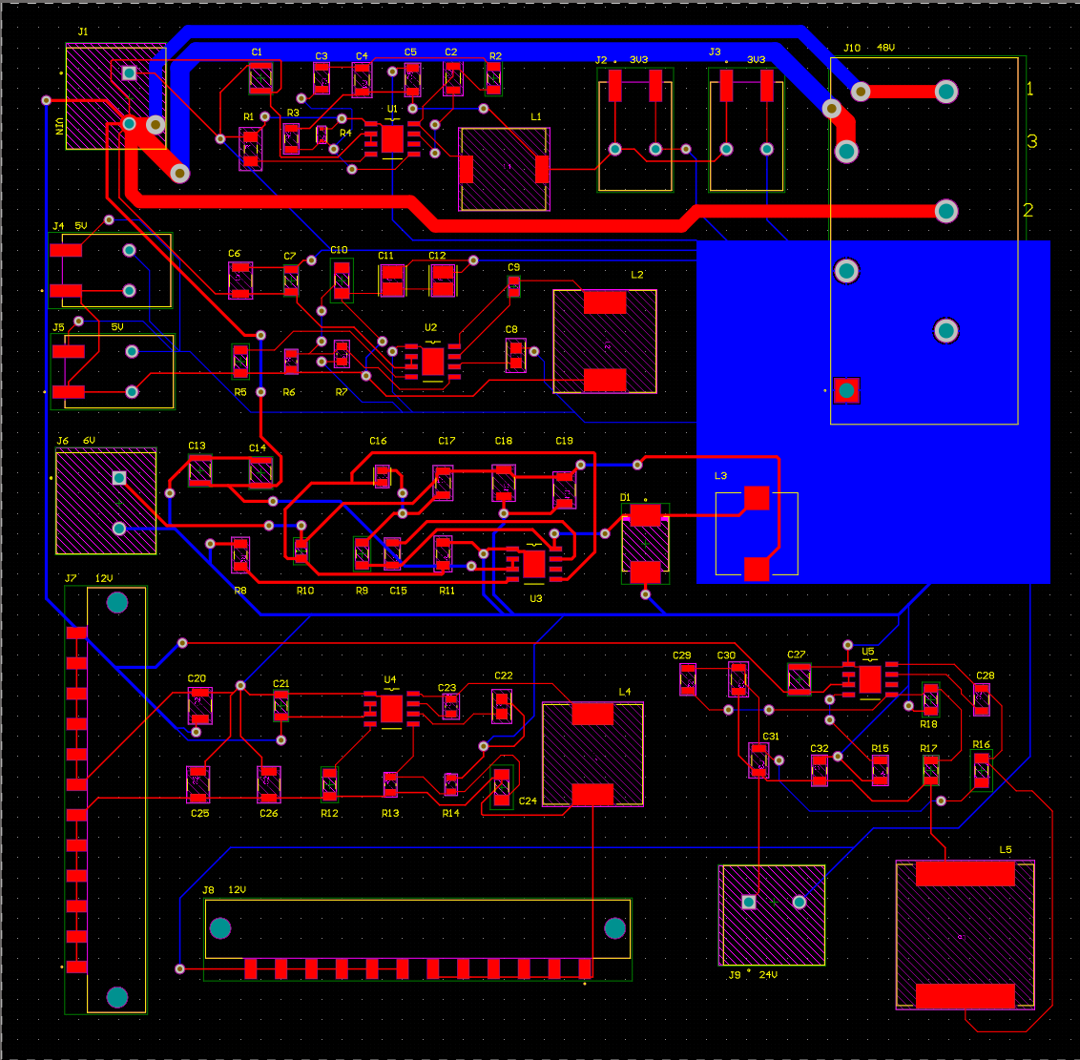
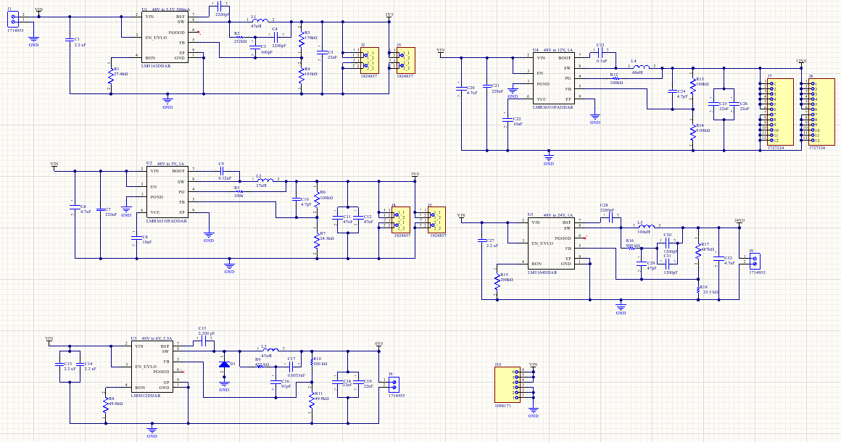
Schematic and PCB Layout
Challenges:
Understanding process of combining each individual power converter circuit
Understanding trace widths and sizing

Slide 14
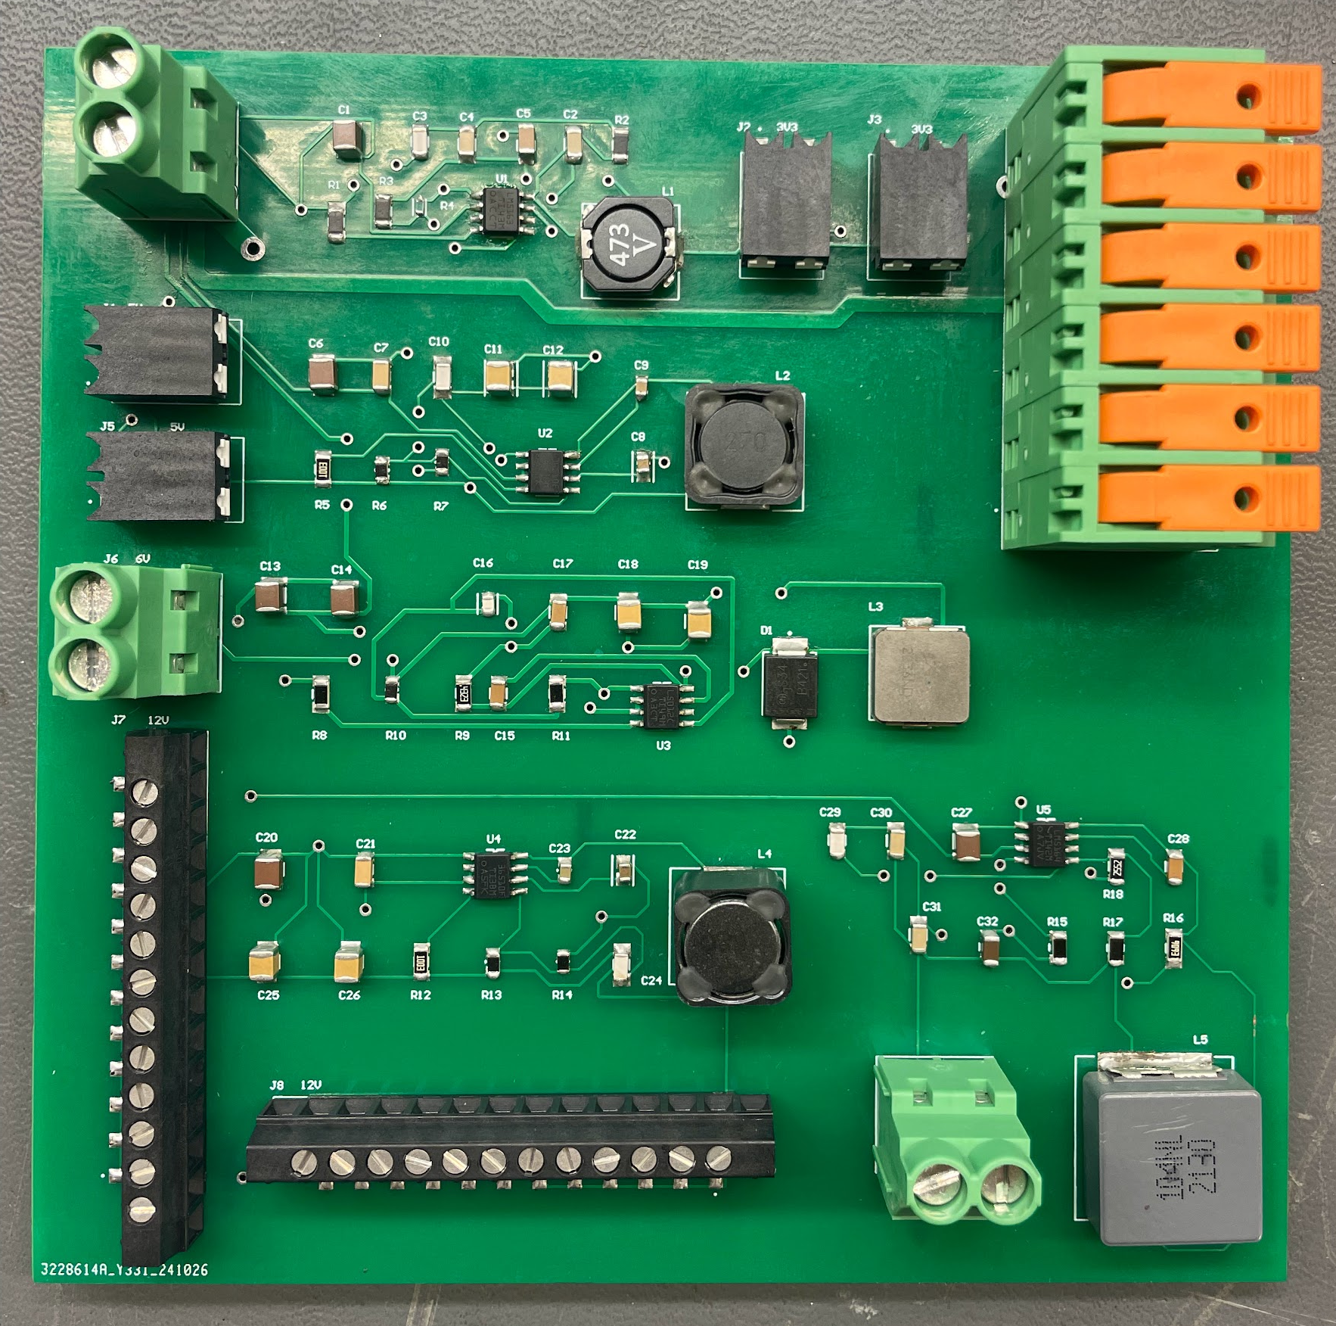
Assembly and Testing
Challenges:
During initial testing, PCB let off smoke
After research, thermal pads on converters weren’t soldered correctly
Resoldered and restested, suspected short
Using 0.5A current limited power supply, only pulling 0.9V at 0.5A, and continued to max current when limit increased
Checked voltages across components, some little to no voltage, but solder joints look okay
Created a debugging log to keep track of results

Slide 15
Remaining Tasks
Remaining 403 Tasks:
Create simulation and verify design itself is correct
Unsolder and isolate certain parts of the circuit and test individually
Complete verification of PCB
404 Tasks:
Design and fabricate battery charger
Design and fabricate enclosure for PCB and battery
Design and fabricate physical design of cobot (team effort)

Slide 16
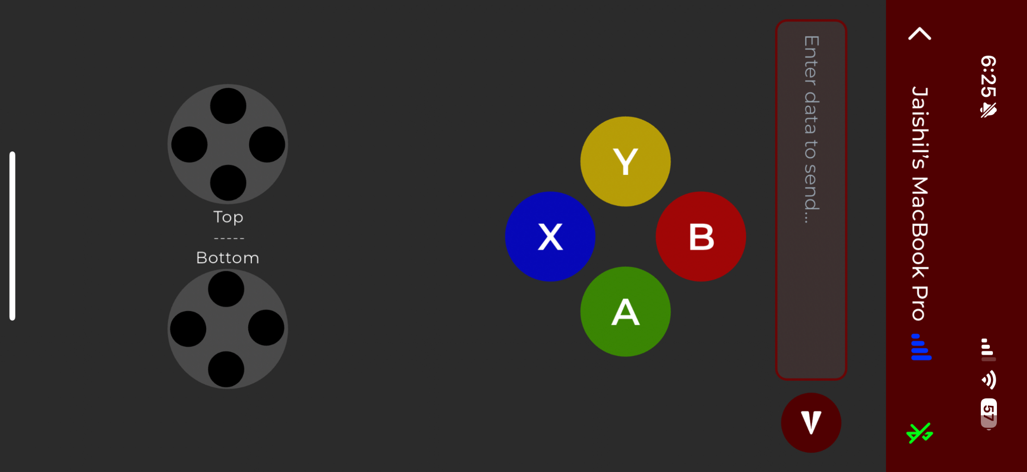
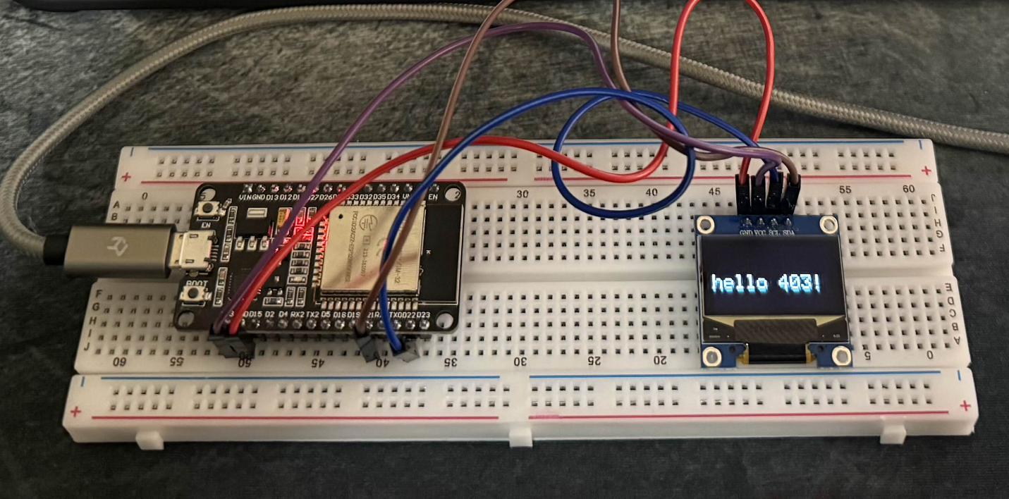
Engineering Design Accomplishments
User Interface / Wireless Connectivity
Jaishil Shah
Developed a mobile application with a complete user interface for Bluetooth connectivity with the ESP-32.
Programmed Arduino code for the ESP32 to enable seamless wireless communication with the mobile app.
Established a wireless system linking the mobile app and ESP-32, displaying "controller" or message inputs on an OLED screen.
Finalized and ordered the PCB design, currently awaiting delivery.
Challenges:
Encountered difficulties in achieving stable Bluetooth connectivity on the mobile device.
Faced complexity in designing an ESP32 PCB capable of handling large inputs and interfacing with a multi-axial cobot.
Worked within limited Altium experience to design and layout the ESP32 board.

Slide 17
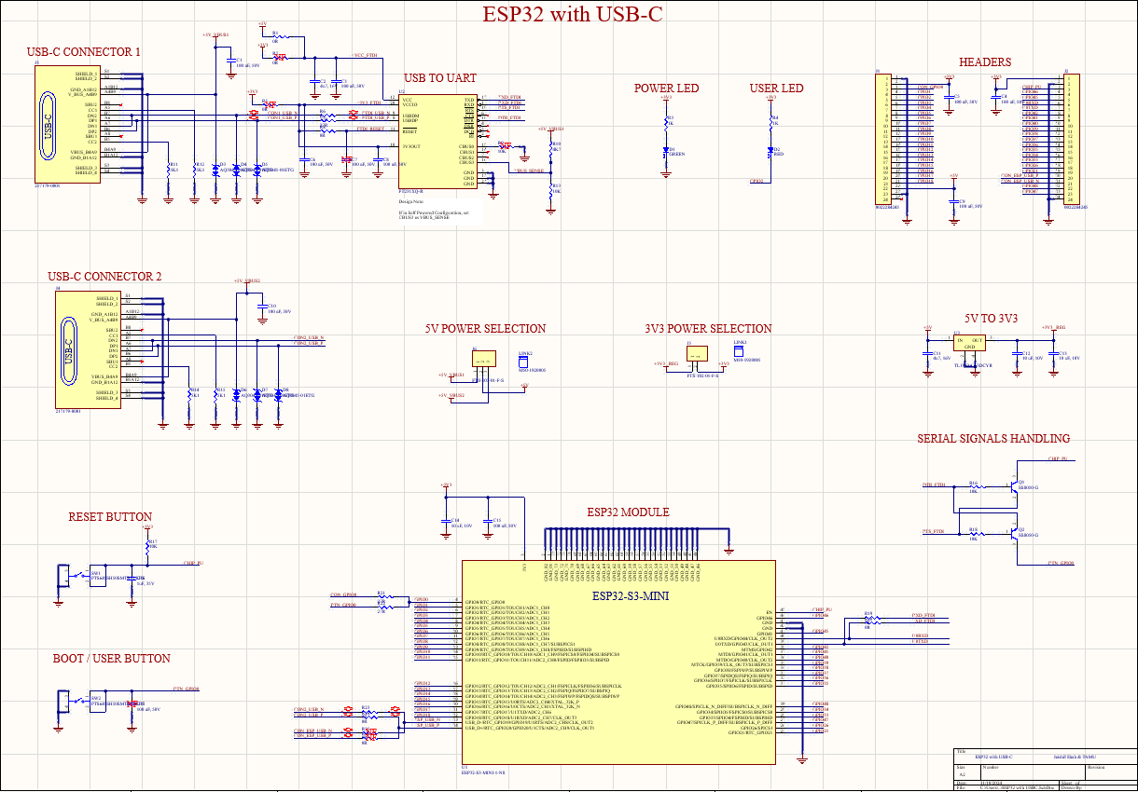
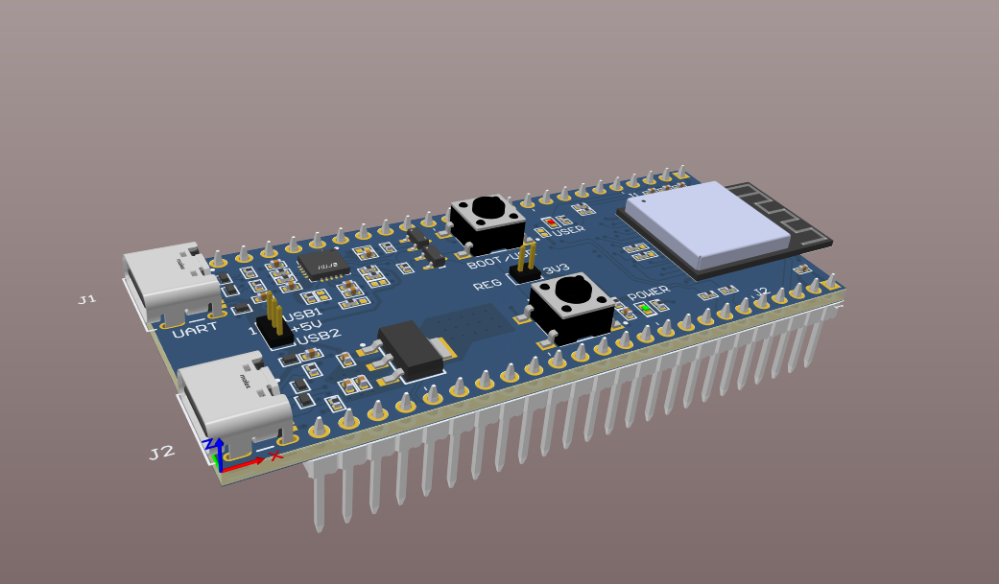
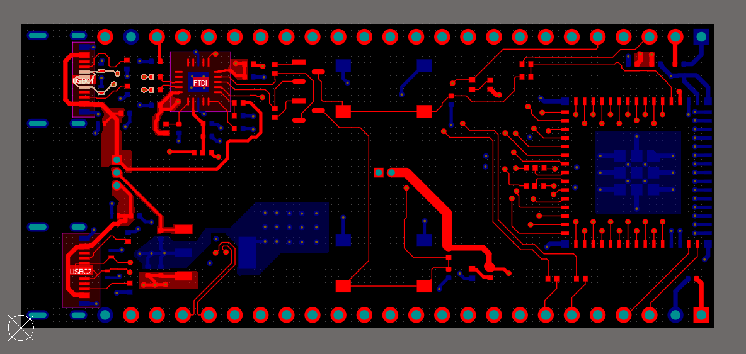
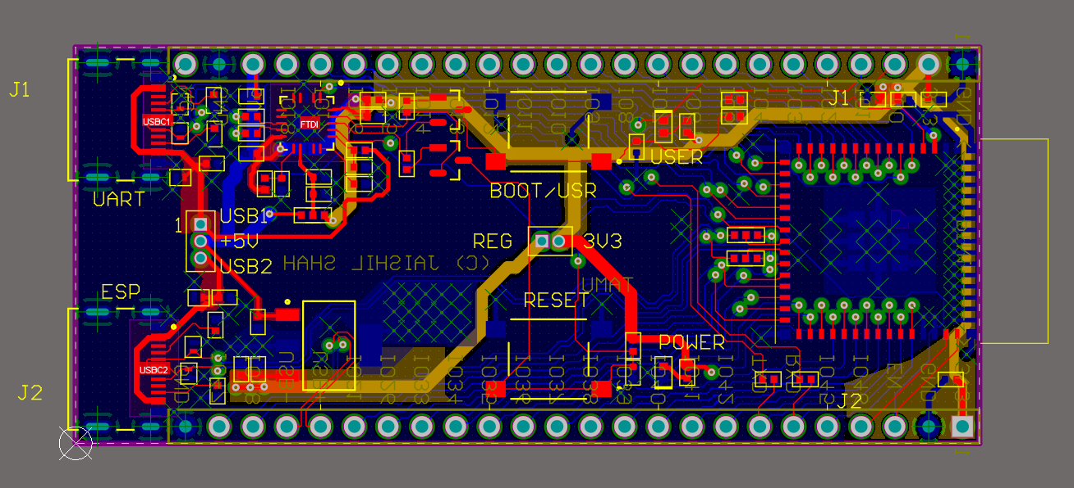
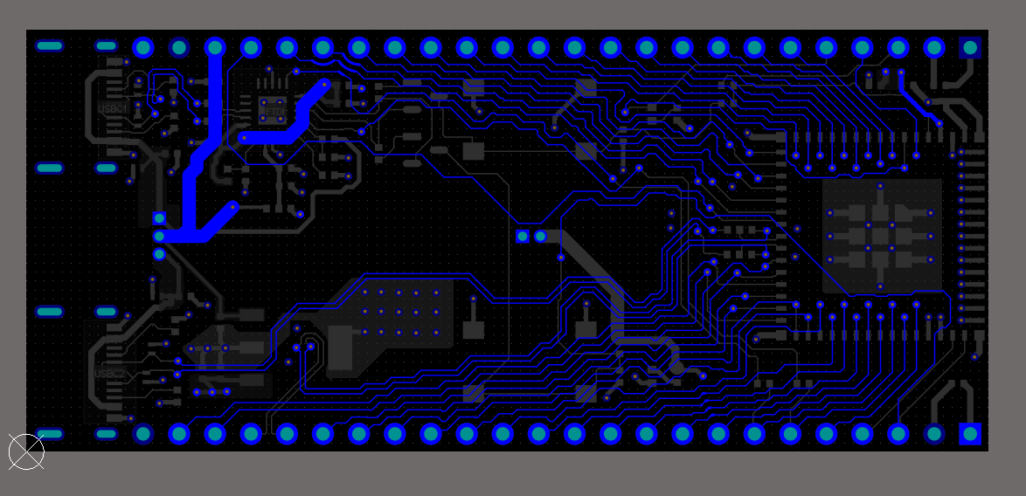
Schematic and PCB Layout
User Interface / Wireless Connectivity
Jaishil Shah
PCB Schematic
3D PCB render
Top-Down View
Bottom View
Full Design View

Slide 18
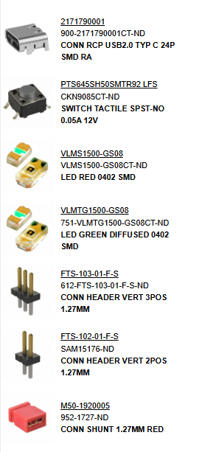
Remaining Tasks
User Interface / Wireless Connectivity
Jaishil Shah
403 -
Practice Soldering (this week) in preparation for the ESP-32
Solder remaining components onto the ESP-32 (once it arrives)
Confirm NEW ESP-32 functions as intended (Bluetooth & input/output)
Establish that all deliverables in the Validation Plan are met
404 -
Design and test ESP-32 compatibility with C2000/Motors
Ensure mobile app. interaction successfully moves cobot arms
Design and Fabricate ESP-32 enclosure and power access
Add complexity and finishing touches to mobile app.

Slide 19
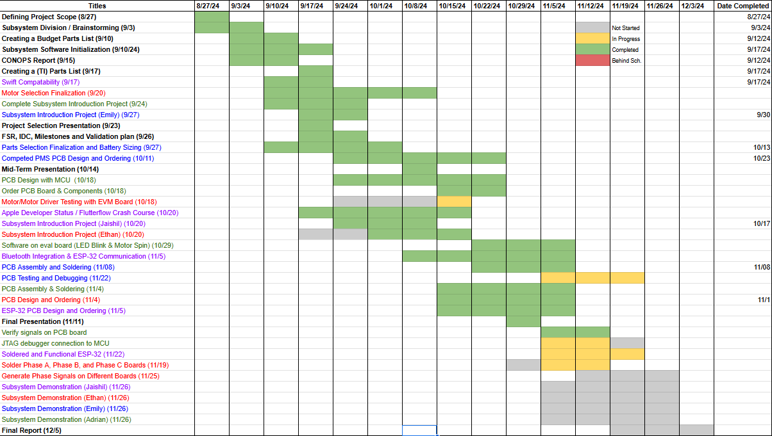
Execution plan

Slide 20
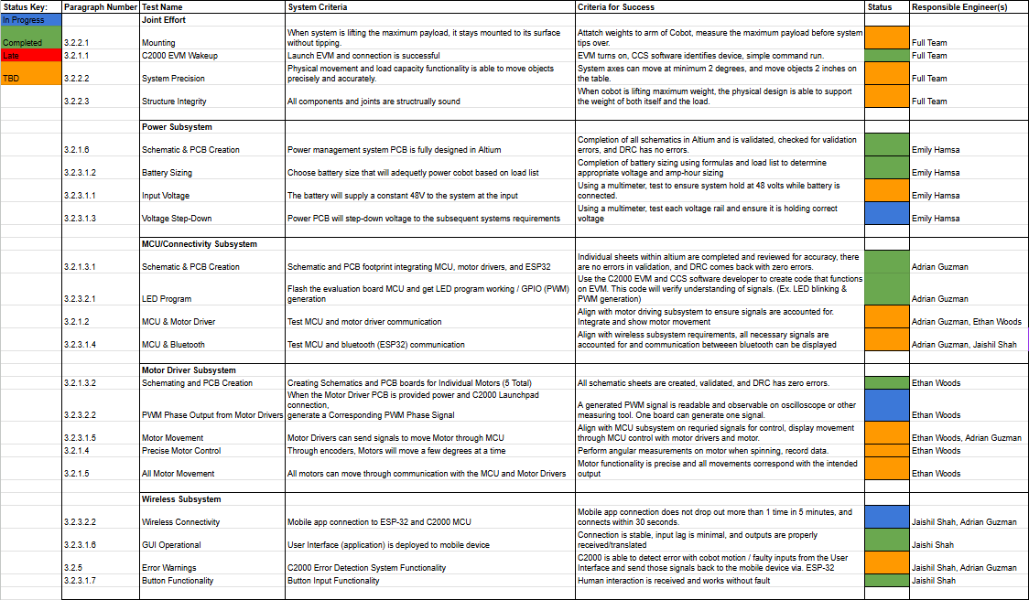
Validation plan
Notes:
Jaishil

